Slide 1
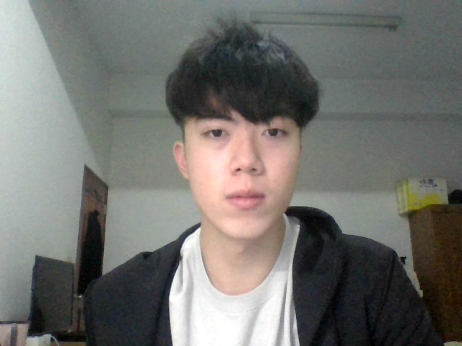
Final Project
TA 王彥珽
Due date: 2023/1/6(Fri) 23:59

Slide 2
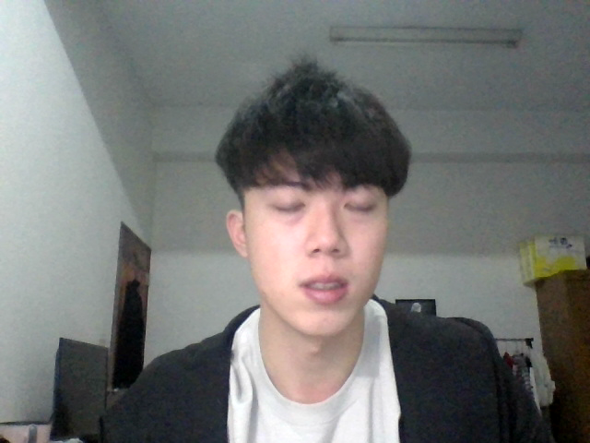
You are asked to build a Live Streaming Server and perform tasks using deep learning model.
You can team up with at most 4 people doing this project.
Overall architecture
Streaming SERVER
Client
Listen
detection, tracking, segmentation…
Segmenter
HTTP
Client
Respond
Client
Camera

Slide 3
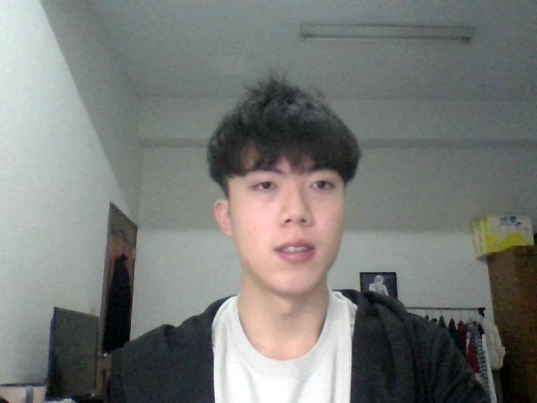
You can create live streaming in two different ways.
1. Compressed
2. W/o compression
DNN model output
Segments (.ts)
Index file (.m3u8)
HTML
View in a browser
Segmenter
(ffmpeg)
tagged
DNN model output
HTML
View in a browser
tagged

Slide 4
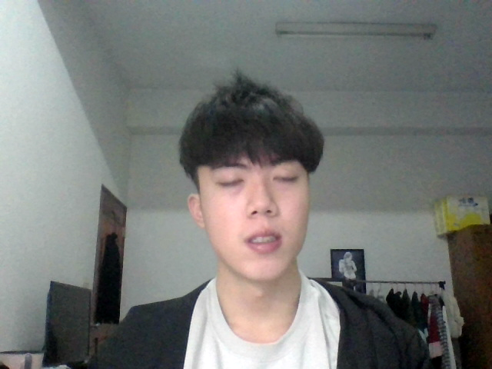
Part1:
Streaming _{(30 points)}
Part2:
Deep Learning Model _{(20 points)}
Part3:
Extensions _{(25 points)}
Demo:
3min presentation + QA _{(10 points)}
On-site Coding _{(15 points)}

Slide 5
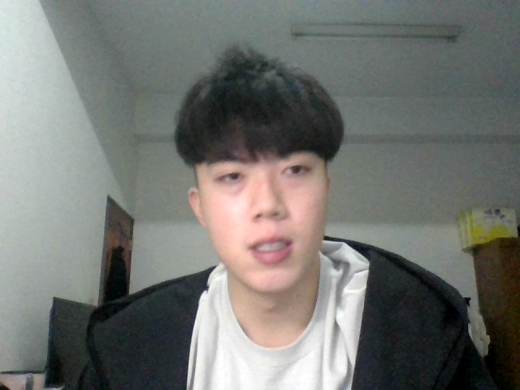
Part 1 Live Streaming (30 points)
You can use any tool to build your streaming server, such as python http.server, flask, etc.
Directly using Twitch, YouTube, Live house, OBS is NOT allowed.
Note that
The encoded file must be a LIVE video segment, thus you will need a camera.
All operations should be implemented in a non-blocking approach. Specifically, the server should be able to handle multiple clients simultaneously and independently.
You should avoid large latency.

Slide 6
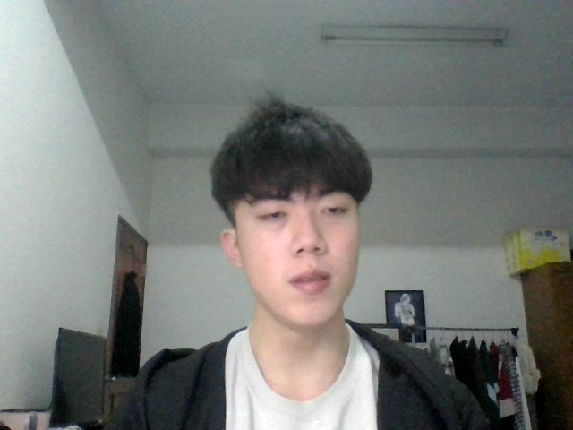
Part 2 Deep Learning Network (20 points)
Use a deep learning network to achieve one of these tasks.
Multiple Object Detection
Object Tracking
Any task that is applicable through live streaming. (You should discuss with TA first)
Note that
You can choose any deep learning model, and there is no need to do any improvement.
You MUST use a deep learning model, instead of simply using functions.
You should consider the speed (FPS) with respect to the functionality of live streaming.

Slide 7
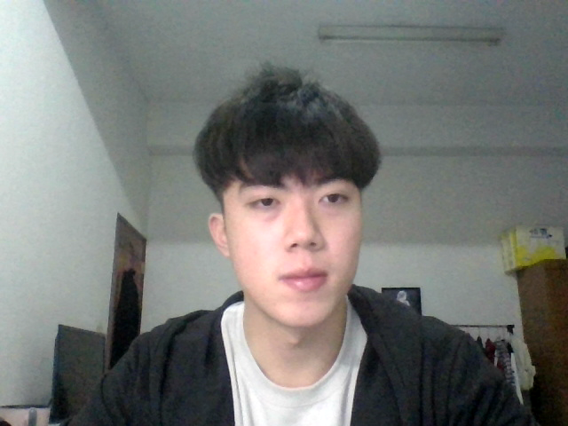
Part 3 Extensions (at most 25 points)
You should provide a user interface for certain functionality.
Button for user to pause/sync to live. (10 points)
Detection: Specify which class to detect. / Tracking: Specify which object to track. (10 points)
Support multiple bitrates/resolution. (10 points)
Other design by yourselves. (at most 10 points, depends on complexity)
Hint
For (c) you probably need to consider using tools(VariantPlaylistCreator).

Slide 8
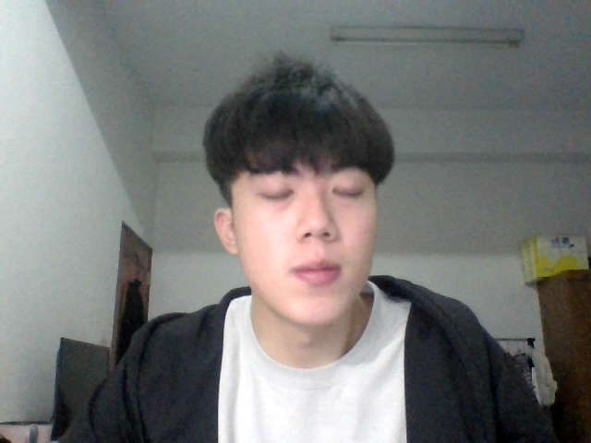
Demo (10 points)
Complete the report(template) and give a brief introduction about your work.
You should be able to answer TA questions during demonstration.
We will view the results in a browser that support HTML5 during demonstration.
On site coding (15 points)
You will be given a question list, simply choose any one of them to solve it. (20 min)
Questions are irrelevant to deep learning model architecture.
These questions will be super easy if you have done the work by yourself.

Slide 9

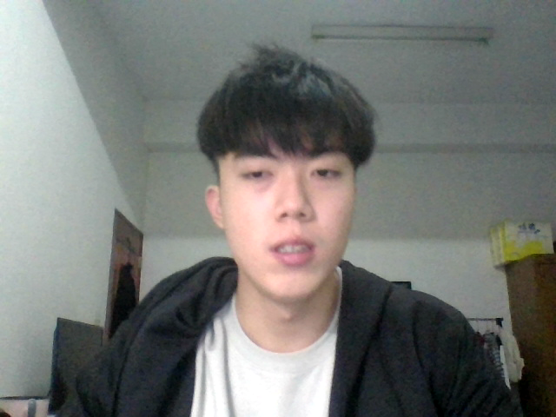
Special Offer (Start from 12/27)
For those who suffer from implementing streaming server, you are welcome to contact TA, we will give you a Christmas gift which contains a template with comments and usage of a well design streaming server(part 1). For fairness you will receive a penalty of 10 points.
Submission
Source code
Report (convert to pdf)
Zip these into a folder name “teamID.zip”, and then upload to E3 before Demo.
Notes
One submission for a team before demo.
You will lose points for any violation or incomplete requirement.
If there is any question, please contact me via E3.
Good Luck!

